Slide 1

Global AI Bootcamp Is that red wine good or bad? How to use Azure Machine Learning Visual Interface to build ML models with no code to predict red wine quality.
Eng Teong Cheah
MVP for AI
@walkercet
Notes:
0 min - (pre-workshop crowd engagement)

Slide 2

Eng Teong Cheah
MVP for AI
walkercet
Notes:
30s – introduce yourself and warm up the crowd
Talk track
-introduce yourself
-talk about how this is a beginner workshop and no previous programming or machine learning knowledge is required.

Slide 3
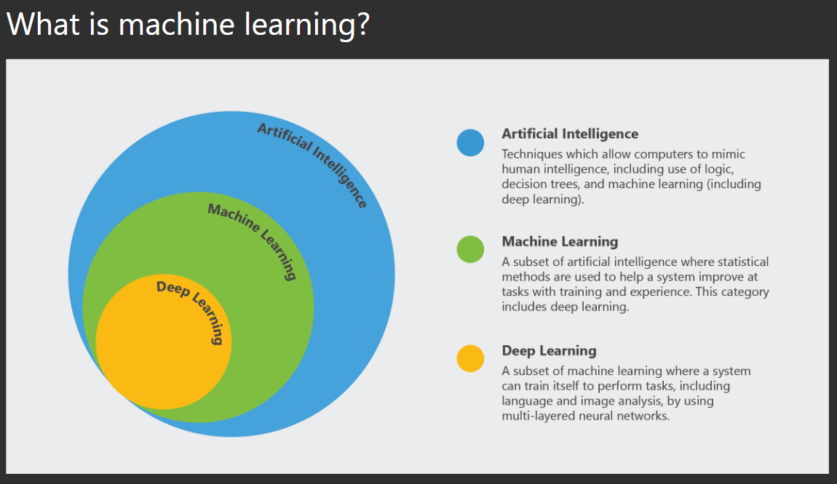
Notes:
5 min – explain machine learning
Machine learning is a subfield of Artificial Intelligence.
Technically, machine learning is a method of data analysis that automates analytical model building.
But we can think of it as a technique to train artificially intelligent systems without needing to be specifically programmed.
Here is a diagram I like that I think puts things into perspective a bit.
So the overarching parent is AI – that covers machine learning and deep learning to simulate human intelligence. Machine learning is statistical methods that include deep learning and deep learning is a subset of machine learning that uses neural networks. Neural Networks are used for language, image classification problems and other deep learning problems.
One funny, and true way of remembering the difference, is that when you’re trying to sell a product, you call it AI. When you’re trying to hire someone to build the product, you call it Machine Learning.

Slide 4
Machine Learning
Model Supervised Training
Traditional Programming
Data
Output
Data
Algorithm
Computation
Algorithm
Computation
Using Model
Data
Algorithm
Output
Output
Notes:
2 min – explain the difference between traditional programming and machine learning
Talk track:
This graphic shows the difference in how traditional programming is created versus a machine learning model.
In traditional programming you have data and a human built algorithm that go through computation to get an output. Static results are generated based on the programmed logic in the algorithm.
In Machine Learning (and specific to supervised machine learning) you have data and the expected output of the data that is put into a computation and a algorithm (model) is created. This is called training your model. Once you have a trained model based on the Features (Data) and Labels (Output) then you can operationalize your model. The production model is used by posting Features (data) to the trained model and an output (label) is predicated based on what it learned from the training data.
Now lets look at the model building process in a bit more detail.

Slide 5
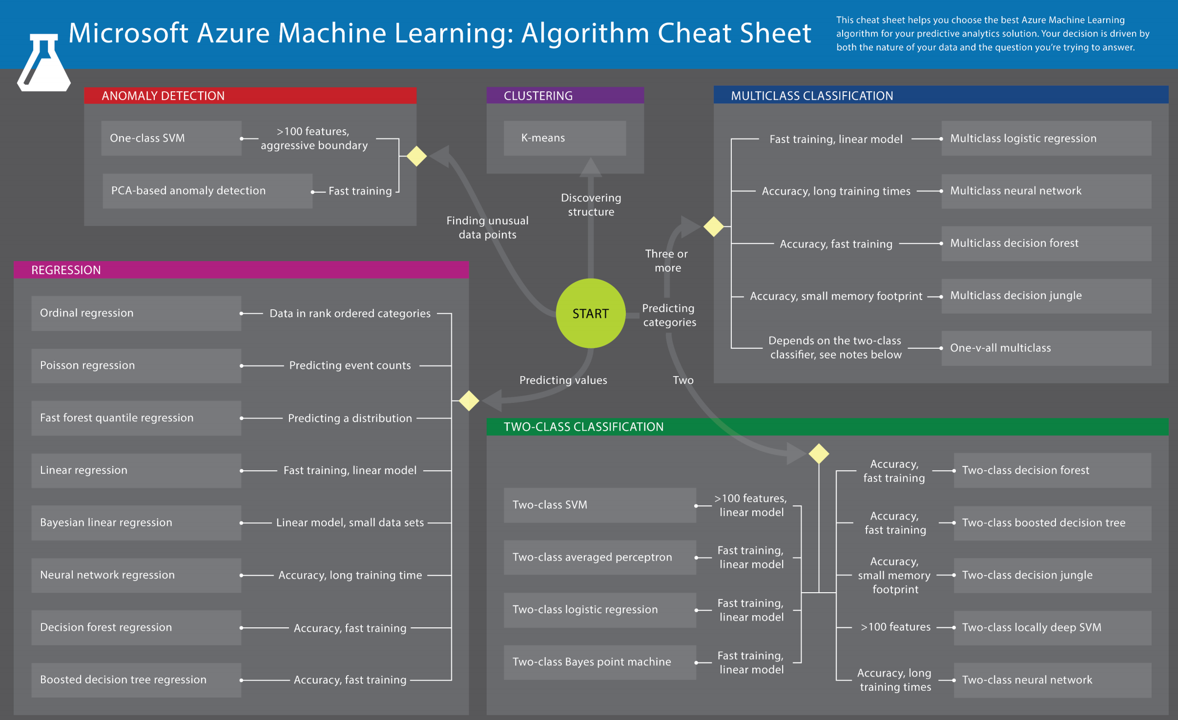
Notes:
This is the cheatsheet to help understand what models should be used for different problems. I really like this because when starting out a path forward can be the hardest part.
You start at the green circle and ask yourself. “What am I trying to predict?”
The biggest help here is from the start to the 5 colored boxes to tell you what type of model you are building.
This is a guideline not a ultimate truth.

Slide 6
Supervised Multiclassification Example
Age | Income | Education | Gender | Housing
61 | $65,000 | Moderate | F | Own
42 | $72,000 | High | F | Rent
18 | $25,000 | Moderate | M | Other
22 | $36,000 | Low | M | Rent
Training data
31 | $52,000 | High | M | ?
What we know
“features”/“attributes”
Thing to predict
“class”/“label”
Notes:
Within Machine Learning there is Supervised Learning and Unsupervised learning.
With Supervised learning you use a dataset with features and labels so it can learn to predict a result based on patterns. Examples of this would be classification and regression models. Classification could be like “cat” or “not cat” and regression is like predicting the value of a home. The above example is showing how to predict the housing class based on demographic information about a person. This is a supervised multiclassification example.
Unsupervised learning is when you give the algorithm a dataset (without labels) and have it learn or find the patterns and labels without being explicitly told.

Slide 7
The Model Building Process
Prepare Data
Train Model
Test Model
Operationalize Model
Raw
Data
Apply learning algorithm to data
Test Candidate
Model with unseen data
Deploy Chosen
Prod Model
Apply preprocessing to data
Select
Candidate
model
Select good enough model
Application posts to API
Prepared
Data
Notes:
3 min – Explain the model building process (keep it brief as you will go into more detail as you build the model in AML Visual Interface)
Prepare Data: The first thing you need is a dataset! Then you need to preprocess your data which we will go over in detail in the demo.
Train Model: Once you have your prepared data its time to test different machine learning models to see which gets the best results for your data. This is iterative because you may need to change the data and/or the model until you think you have a candidate for the production model.
Test Model: Now you have a model that you think is going to perform well and you can test it with unseen data. You will prep your data the same way you processed it for training and then score the labels based on the data provided. This is an iterative process as you may need to go back to the beginning and change how you prepare your data or change your features. Its definitely a fail fast process so don’t overthink each step. Get out what you think will work and iterate through until you get a model that performs good enough on your unseen data.
Operationalize Model: Once you have the “chosen one” aka your chosen model. Its time to operationalize it so you can consume it from different applications.

Slide 8

Machine Learning/AI tools When to use what?
Microsoft AI Platform
Build your own or consume pre-trained models?
Build your own model
Use pre-built models
Azure Machine Learning
Cognitive Services, Bot Services
Customize?
Which experience do you want?
Code-first
Visual-tooling
Tools & Services
Machine Learning
Workbench + Services
Machine Learning Studio
What engine(s) do you want to use?
SQL Server
Spark
Hadoop
Azure Batch
DSVM
Azure Container Service
Notes:
1 min – Overview/Decision tree of different machine learning options in Azure
Here you can see that you went over the prebuilt model options before this demo. Now we are going to check out the build your own custom model options in azure. We are going to talk about the visual tooling in azure machine learning studio but also take note of the other path/options if you decide to go code-first in the future.

Slide 9
Workshop Azure Machine Learning Visual Interface Is that red wine good or bad?
Notes:
Workshop instructions can be found on github: https://github.com/cassieview/wine-quality-azure-ml-visual-interface

Slide 10
<Name Here>
<Title>
<Twitter>
Notes:
30s – introduce yourself and warm up the crowd
Talk track
[introduce yourself]

